Slide 1

UPI Payment Failure Analysis
A structured practice framework for fintech operations analysts — using a public UPI dataset to surface concentrated failure patterns, build SQL fluency, and deliver executive-ready diagnostics.
EXCEL / CSV
PYTHON / PANDAS
MYSQL / POSTGRESQL
POWER BI

Slide 2
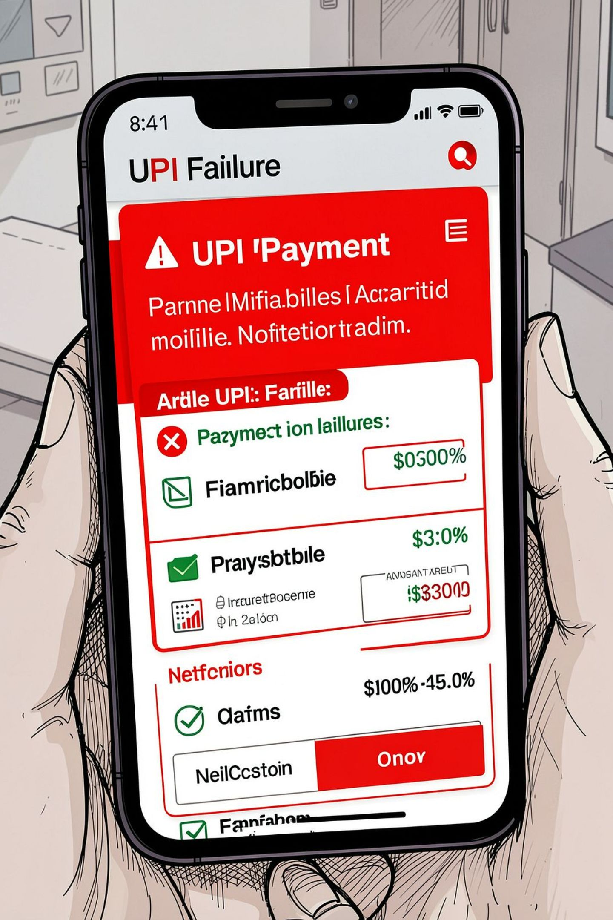

The Business Problem
Payment failures erode revenue, damage customer trust, and strain operations. The UPI dataset provides real-world transaction records — enabling analysts to locate failure concentration, quantify financial exposure, and deliver actionable diagnostics to payment operations teams.
Treat the dataset as a practice source. Document the exact file name and version used in your project to ensure reproducibility.

Slide 3
Analysis Framework: Three Layers
Measure
Diagnose
Report
Calculate overall failure rate, segment by payment method, bank, device, network, and transaction amount bucket.
Identify peak failure hours, high-risk bank × device combinations, and banks exceeding minimum-volume thresholds.
Quantify failed transaction value share by bank and payment method. Deliver an executive KPI page and a diagnostic drill-down.

Slide 4
Data Cleaning: Eight Foundational Steps
01
02
Verify transaction_id uniqueness
Parse timestamps — extract date, month, and hour
03
04
Flag missing status, bank, device, and amount fields
Standardize status and payment-mode labels
05
06
Check for zero, negative, and extreme transaction amounts
Create a binary failure_flag column
07
08
Build amount buckets for segmentation
Document minimum-volume thresholds before rate comparisons

Slide 5
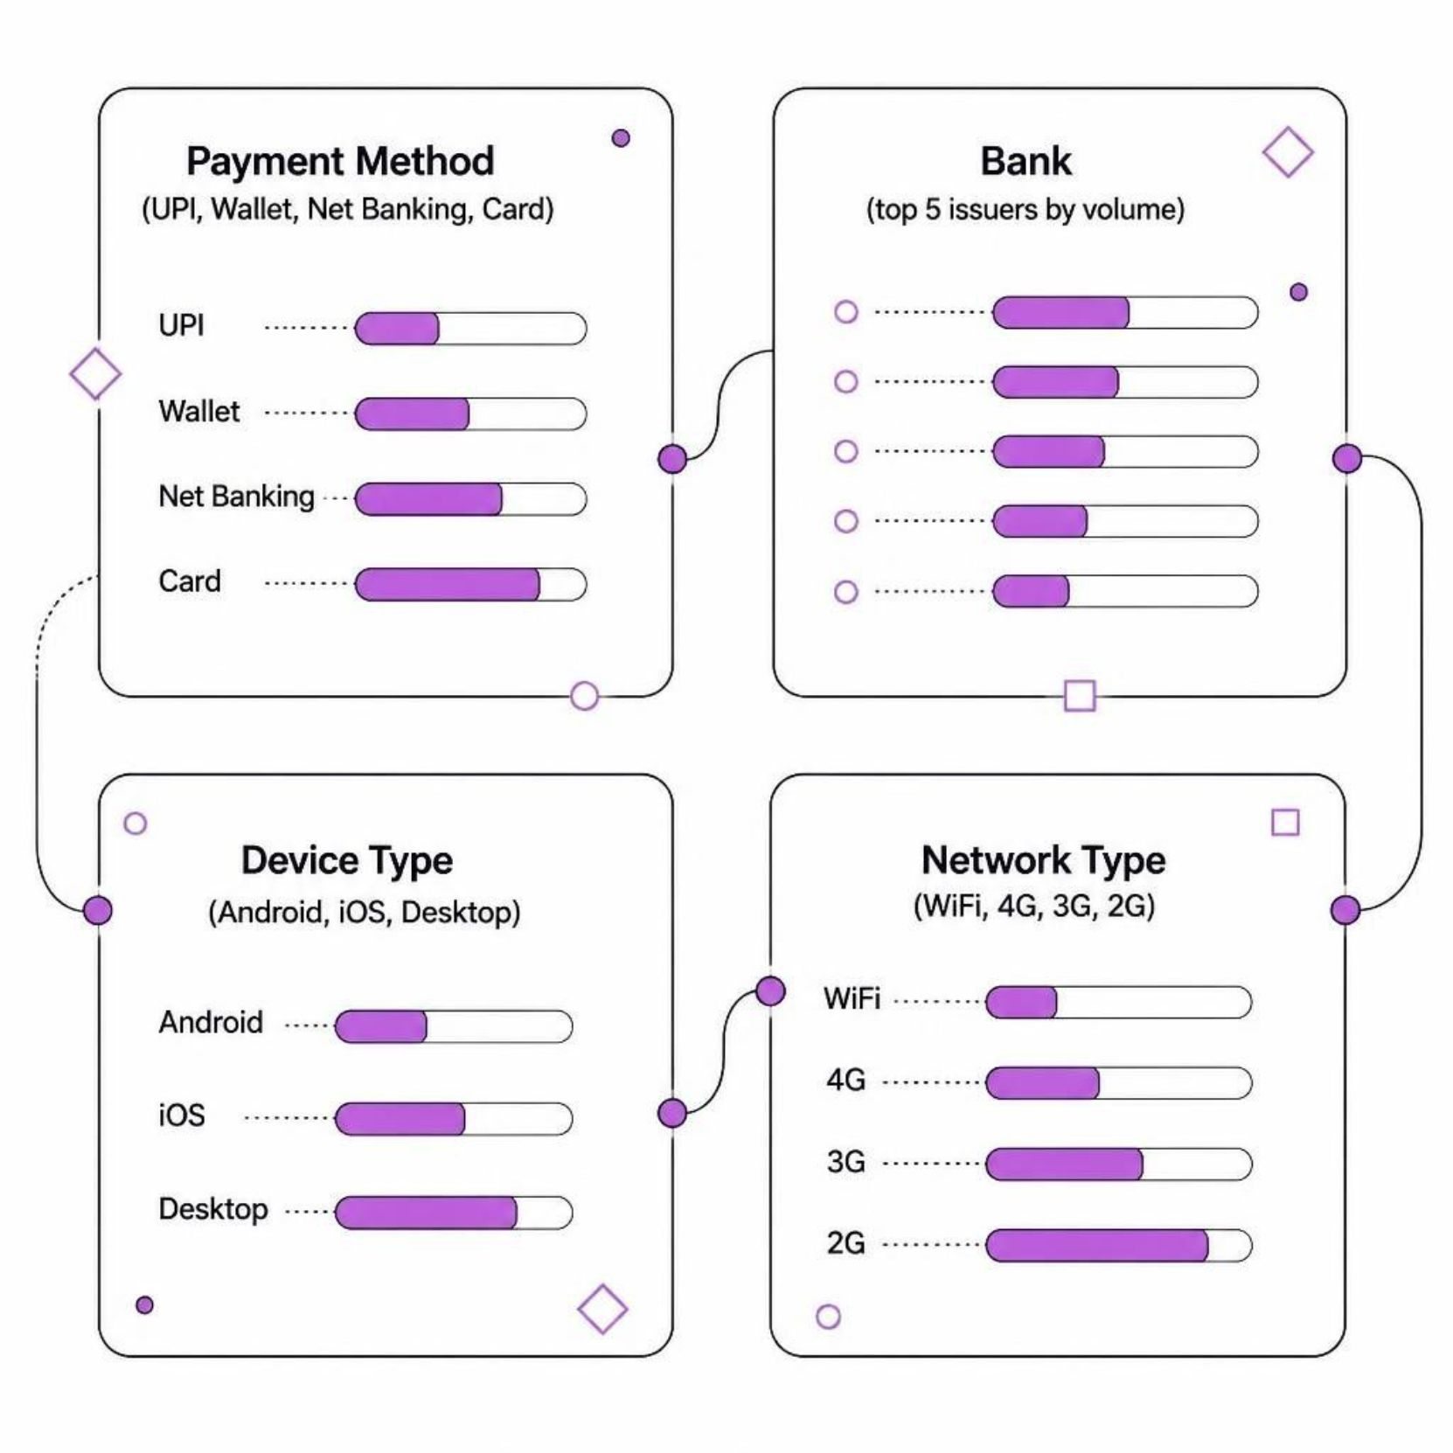
Failure Rate Segmentation
What to investigate
Which payment methods carry the highest failure rate?
Which banks process the most failed transactions?
Do failure rates differ significantly by device type?
Does network type correlate with failure frequency?
Always apply a minimum transaction-volume threshold before comparing rates across segments.

Slide 6
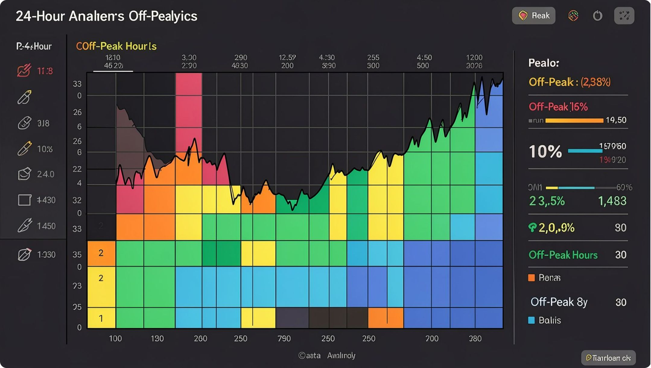
Time & Value Dimension Analysis
Temporal Patterns
Identify hours of the day with unusually high failure rates. Peak traffic windows often reveal infrastructure strain or third-party gateway latency.
Transaction Value Exposure
Segment by amount bucket to find where failure risk concentrates. Then quantify the share of total failed transaction value attributable to each bank and payment method.

Slide 7



SQL Practice: Progressive Skill Building
Foundational Queries
Use SELECT, COUNT/SUM/AVG, and GROUP BY to compute overall failure rate and segment by payment method and bank.
Conditional Aggregation
Apply CASE WHEN and percentage calculations to compare failure rates across device type, network type, and transaction amount buckets.
Advanced Techniques
Use date functions, CTEs, and window functions for temporal analysis — peak hours, rolling rates, and cross-segment comparisons.
Drill-Down Interpretation
Answer bank × device cross-tabs and failed value share questions. Compare segments — never report totals alone. Write one business sentence beneath every saved query.

Slide 8
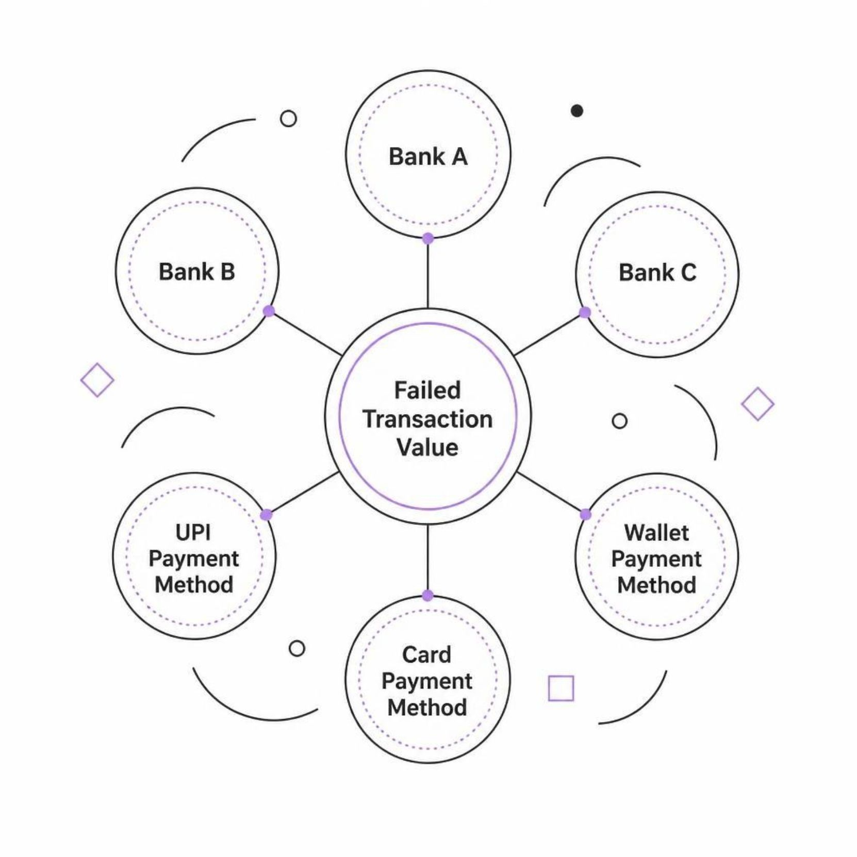
Cross-Segment Drill-Down
Bank × Device Combinations
Cross-tabulate bank and device type to isolate the highest-risk combinations. These reveal whether failures are bank-specific, device-specific, or concentrated in particular pairings — directly informing where to focus remediation.
Failed Value Share
Calculate what share of total failed transaction value each bank and payment method accounts for. This shifts the lens from transaction count to financial exposure — the metric that matters most to stakeholders.

Slide 9
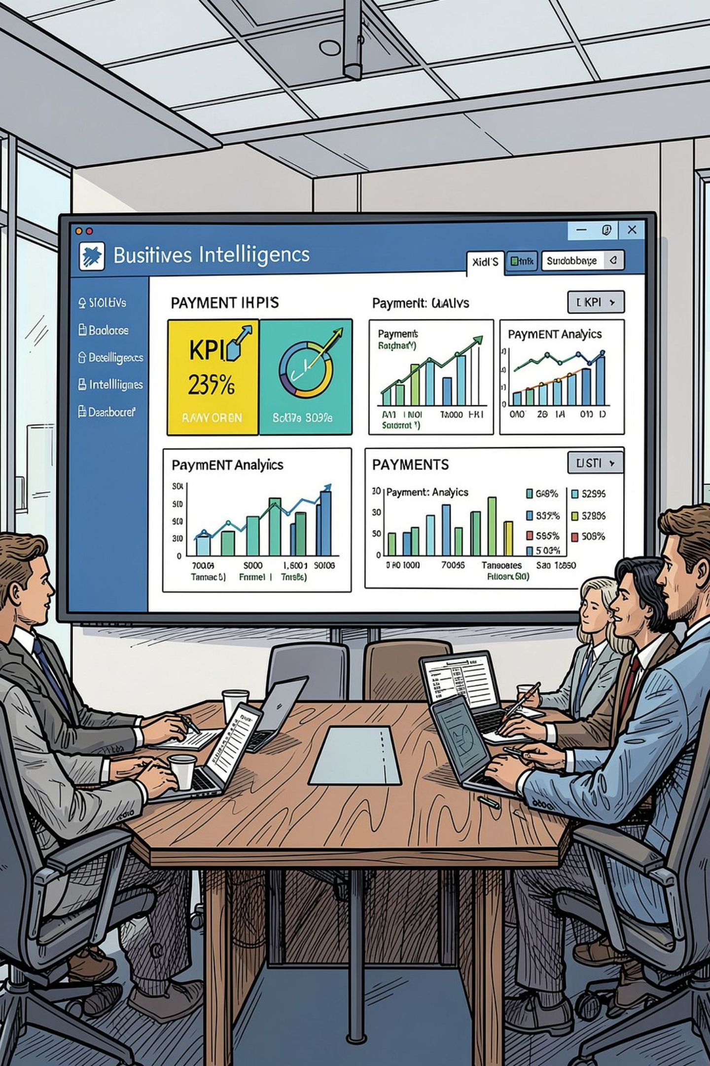
Dashboard Design: Two-Page Structure
Page 1 — Executive KPI Page
Overall failure rate, total failed transaction value, top 3 banks by failure volume, and highest-risk payment method. Designed for rapid stakeholder comprehension — no drill-down required.
Page 2 — Diagnostic Page
Drill-downs by bank, device, network, time-of-day, and amount bucket. Every chart must map back to a specific analysis objective. This page answers the "why" behind the KPIs.

Slide 10

Key Takeaways
Clean First, Analyze Second
Thresholds Prevent Noise
Document every transformation step. Inconsistent labels and unhandled nulls silently corrupt failure rate calculations.
Always apply a minimum transaction-volume threshold before comparing rates. Small-sample banks distort rankings and mislead decisions.
Value Over Volume
Every Query Needs a Business Sentence
Failed transaction value share is the stakeholder metric. A bank with fewer failures but larger average amounts may represent greater financial risk.
Save each query in your project file and write one clear interpretation beneath it. Analysis without communication has no operational impact.

